Slide 1

AI Ninja Series – Day 3

Slide 2

Re-Cap of Day 2 + Challenge Queries

Slide 3
Day 3

Slide 4
Language | Text Analytics
The Text Analytics API is a cloud-based service that provides advanced natural language processing over raw text, and includes four main functions: sentiment analysis, key phrase extraction, language detection, and entity recognition.
Sentiment Analysis - Sentiment Analysis tells whether the given phrase is positive or Negative. The Api returns values between 0 to 1 . If the value is close to 1 it indicates the phrase is positive, if it close to 0 it indicate the phrase is negative.
Key Phrase Extraction - Helps you in identifying all Key words available in the phrase. the document is bigger. Document size must be under 5,120 characters per document, and you. This works better when can have up to 1,000 items (IDs) per collection.
Language Detection- You can detect which language the input text is written in and report a single language code for every document submitted on the request for up to 120 languages.
NER(Named Entity Recognition) is the ability of Text Analytics which identifies the Entities available in the phrase
.

Slide 5
Language| Text Analytics
API Request and Response
https://azure.microsoft.com/en-in/services/cognitive-services/text-analytics/
Demos
.

Slide 6
Language| Text Analytics
Use Cases
.
Product / Any Entity Text Based Feedback Sentiments
Building out Data Pipelines that automatically extracts data from multiple sources
Building out Knowledge Mining Use cases

Slide 7
Language| QnA Maker
Create an FAQ service from existing content
.
Knowledge Base out of semi-structured content like FAQ documents, URLs, and product manuals and answers natural language questions by matching it with the best possible answer from the QnA’s in your Knowledge base.
https://www.qnamaker.ai
QnA Maker Life Cycle
Step 1: Create a QnA Maker resource in the Azure portal.
Step 2: Create a knowledge base in the QnA Maker portal. Add files and URLs to create the knowledge base.
Step 3: Publish your knowledge base and test from your custom endpoint using cURL or Postman.
Step 4: From your client application, programmatically call your knowledge base's endpoint. The client application processes the JSON response to show the best answer to the user.

Slide 8
Language | LUIS
Language Understanding (LUIS) is a cloud-based API service that applies custom machine-learning intelligence to a user's conversational, natural language text to predict overall meaning, and pull out relevant, detailed information.
A LUIS app contains a domain-specific natural language model. You can start the LUIS app with a prebuilt domain model, build your own model, or blend pieces of a prebuilt domain with your own custom information.
Prebuilt model LUIS has many prebuilt domain models including intents, utterances, and prebuilt entities. Prebuilt domain models include the entire design for you and are a great way to start using LUIS quickly.
Custom Model LUIS gives you several ways to identify your own custom intents and entities including machine-learned entities, specific or literal entities, and a combination of machine-learned and literal.
.

Slide 9
Language | LUIS
Concepts in LUIS
Utterances are the Inputs from the user which app needs to interpret.
2. Intents User Intention
3. Entities Extracts data from the utterance. LUIS offers different types of entities for different types of data.
.

Slide 10
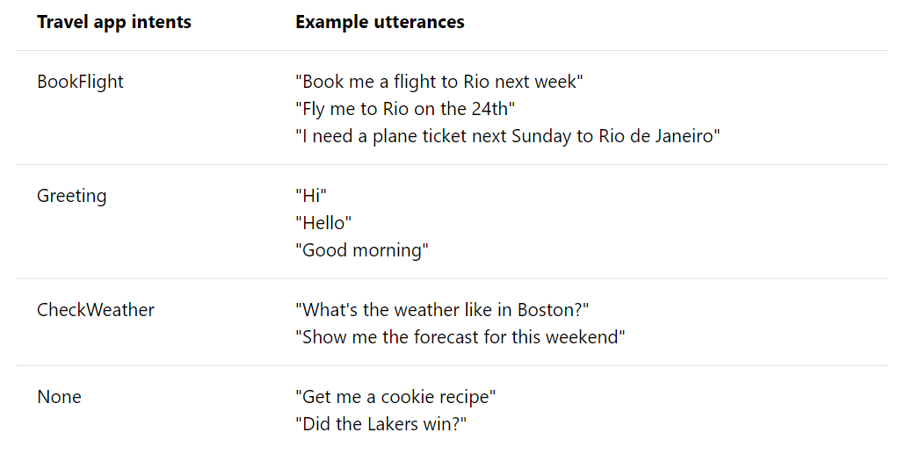
Language| LUIS
Concepts in LUIS
.
Intent : An intent represents a task or action the user wants to perform. It is a purpose or goal expressed in a user's utterance.

Slide 11
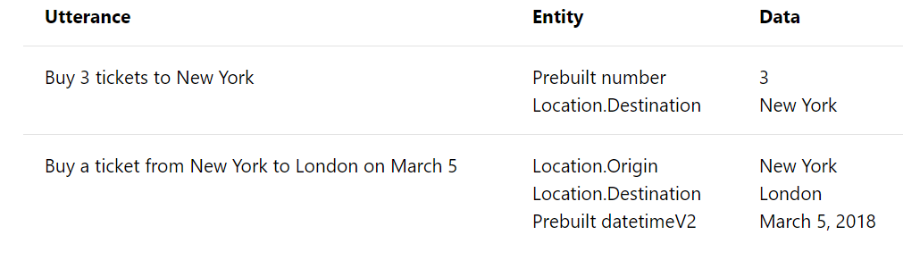
Language| LUIS
Concepts in LUIS
.
Entity : Entity represents a word or phrase inside the utterance. Represents a class including a collection of similar objects (places, things, people, events or concepts). Describes information relevant to the intent

Slide 12
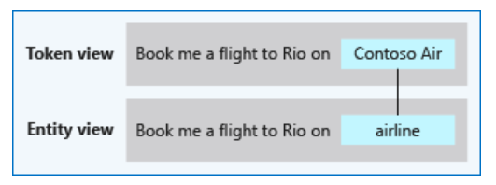
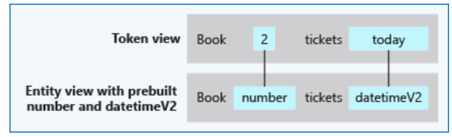
Language| LUIS
Concepts in LUIS
.
Types of Entities :
Simple entity : A simple entity is a generic entity that describes a single concept and is learned from the machine-learned context. Because simple entities are generally names such as company names, product names, or other categories of names
Prebuilt entity : Prebuilt entities are built-in types that represent common concepts such as email, URL
and phone number

Slide 13
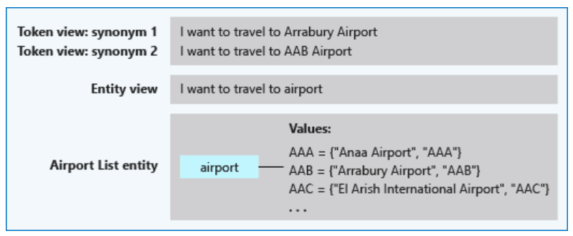
Language| LUIS
.
List entity : List Entity is used when your data has related words or synonyms.
The entity is a good fit when the text data:
Are a known set
The text in the utterance is an exact match with a synonym. LUIS doesn't use the list beyond exact text matches. Stemming, plurals, and other variations are not resolved with a list entity. To manage variations, consider using a pattern with the optional text syntax.

Slide 14
Language| LUIS
.
Pattern.Any :Pattern.any is a variable-length placeholder used only in a pattern's template utterance to mark where the entity begins and ends.
I have completed {TaskDetails} today
I have completed Abc Module Development, integration with LoB1 and unit testing today
I have completed Abc Module coding which took more than 3 hours of my time today
I have completed Parcel A Delivery today
The entity is a good fit when the text data:
The ending of the entity can be confused with the remaining text of the utterance

Slide 15
Language| LUIS
.
Regular expression : Regular Expression Entity is used to pull out wel - formatted data.
If you are working with any Human Resources app and you need to pull out data based on HRF no’s then you can use this Entity.
For Example ,
I would like to view the status of hrf-13450
When is hrf-76543 got updated?
Format used here is hrf-[0-9]{5}

Slide 16
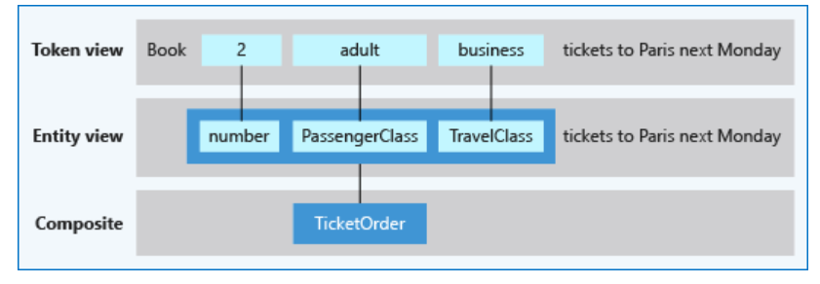
Language| LUIS
Composite Entity : A composite entity is made up of other entities, such as prebuilt entities, simple, regular
expression, and list entities. The separate entities form a whole entity. This entity is a good fit when the data -
Are related to each other | Need to be grouped and processed by the client application as a unit of information.

Slide 17
Language| LUIS
Building LUIS Model
https://www.luis.ai
.

Slide 18
Language| LUIS
Benefits
Add natural language understanding to your apps
Quickly build a custom language solution
Always learning and improving
Enterprise-ready, available worldwide
.

Slide 19
Language| LUIS
Best Practices
Define distinct intents – ( Book a flight, book a hotel)
Find a sweet spot between too generic and too specific for each intent ( MakePayment, MakePaymentwithCouponValue)
Build your app iteratively ( 3 Datasets – Training, Testing and Review)
Don't add many example utterances to intents
Don't add many example utterances of the same format, ignoring other formats
Add phrase lists and patterns in later iterations
Balance your utterances across all intents except the None intent.
Don't mix the definition of intents and entities
Monitor the performance of your app
.

Slide 20
Conversational Commerce
Azure Bot Service

Slide 21

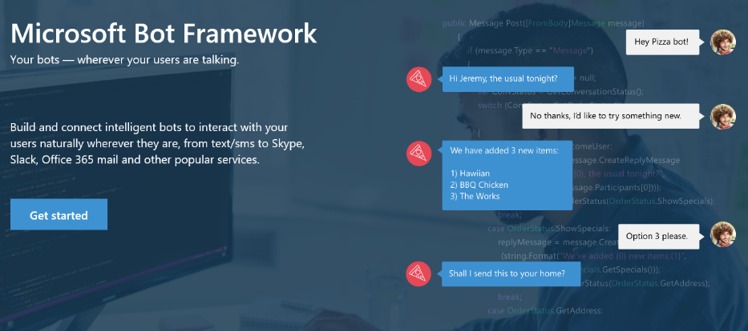
Your bots – wherever your users converse
Your Bots – where your users converse
Intelligence
Cognitive Services
Bot Framework
Cortana
Bot Connector Service: A service to register your bot, configure channels and publish to the Bot Directory. Connect your bot(s) seamlessly to text/sms, Office 365 mail, Skype, Slack, Twitter, and more.
Bot Builder SDK: An open source SDK hosted on GitHub. Everything you need to build great dialogs within your Node.js or C# bot
Bot Directory: A public directory of bots registered through the Bot Connector Service. Discover, try, and add bots to conversation experiences
Notes:
Microsoft Bot Framework enables organizations to build intelligent agents (Bots) that allow your intelligent systems to interact with your users in more contextual and natural ways, from text/sms to Office365 mail to Skype, Slack and other services. The Bot Framework provides developers with a developer portal & SDK to build your bot, a bot connector service to connect to social channels such as Twitter, Slack etc. and a bot directory to discover and use existing bots.
T: Next, Cortana.

Slide 22
Bot Framework ( Conversational Commerce )
Intelligence
Introduction
Azure Bot Service
Bot Builder
Cognitive Services
App Economy to Bot Economy
Basic
Introduction + SDKs
Bot Framework
Conversational Commerce
Form
Bot Simulator
Cortana
About Azure Bot Framework
LUIS
Bot Connectors
Industry Case Studies
Proactive
Bot Framework Portal
Q&A

Slide 23
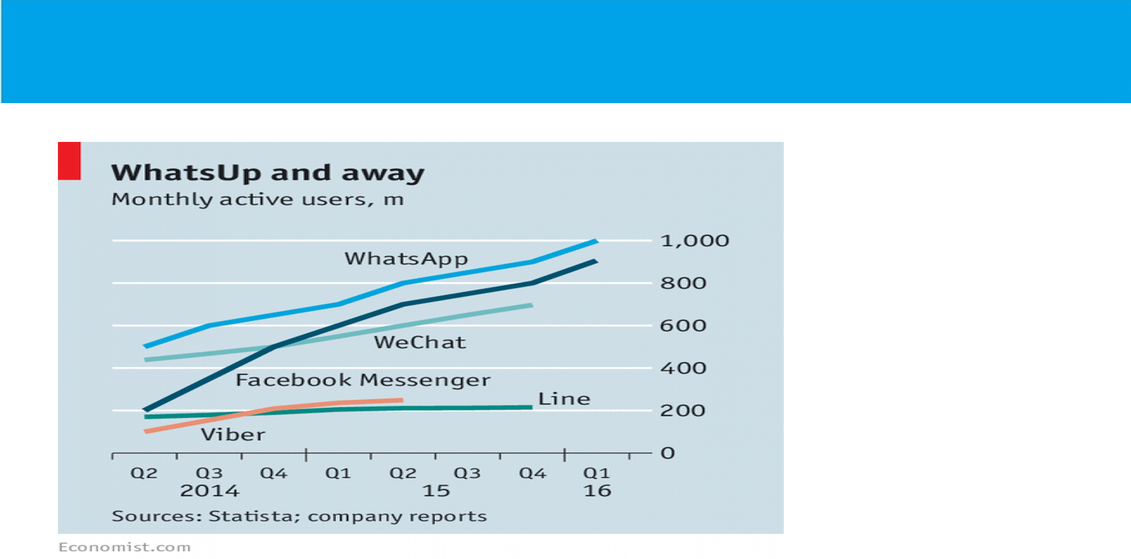

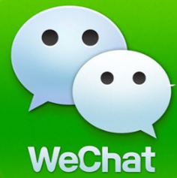


App Economy to Bot Economy

Slide 24
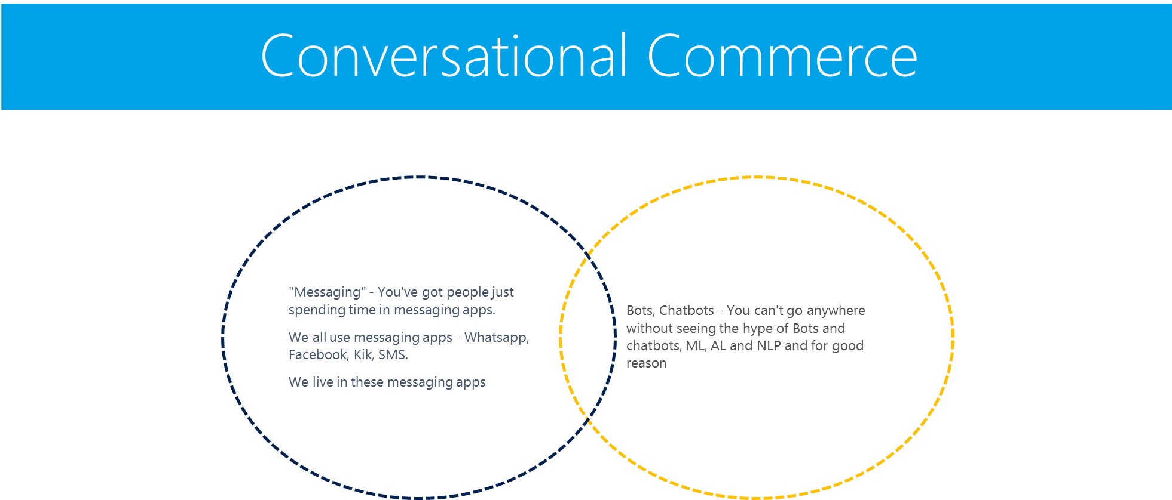

Slide 25
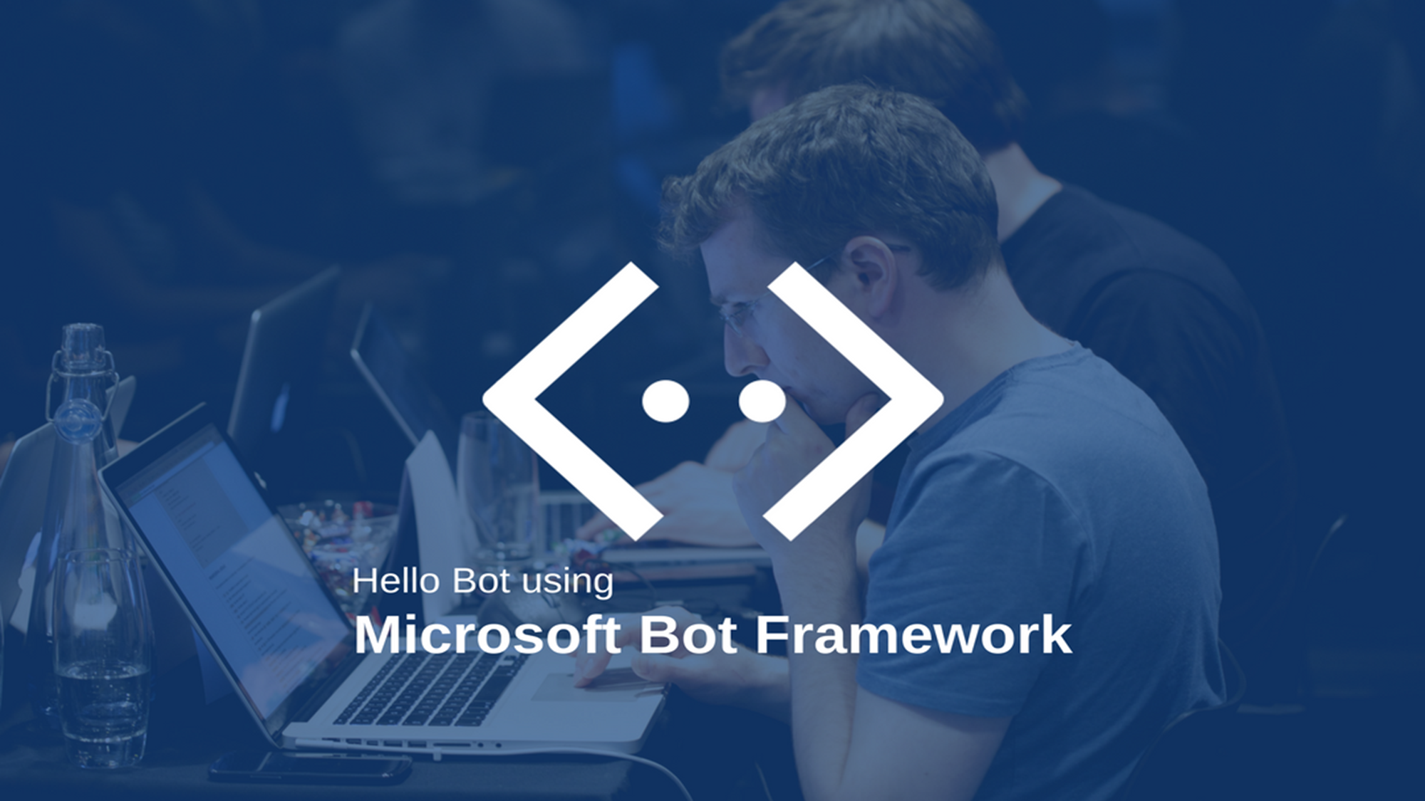
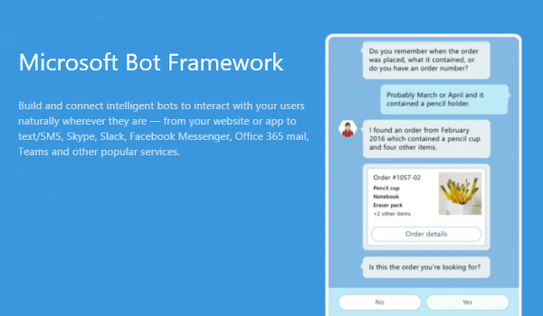
Notes:
About Bot Framework
The Bot Framework is a platform for building, connecting, testing, and deploying powerful and intelligent bots. You can quickly start building bots with the Azure Bot Service. If you prefer building a bot from scratch, the Bot Framework provides the Bot Builder SDK for .NET and Node.js.
Let's look at an example of a bot that schedules salon appointments. The bot understands the user's intent, presents appointment options using action buttons, displays the user's selection when they tap an appointment, and then sends a thumbnail card that contains the appointment's specifics.

Slide 26
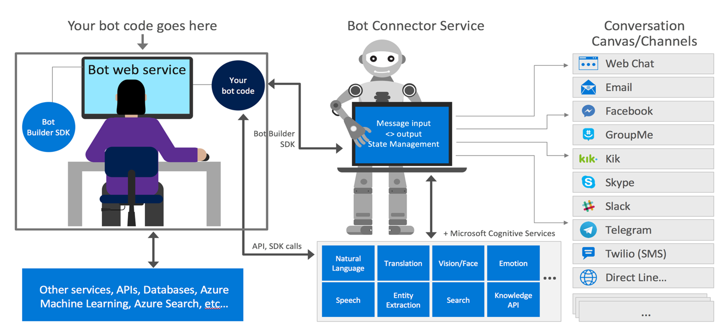
Bot Frame Work Components

Slide 27
Chat Bots| Demos/ Code Walk Thro / HoLs
.
Basic Bot
Waterfall Bot
Form Based Bot
QnA Bot
LUIS Bot

Slide 28
Chat Bots| Key Bot Scenarios
.
Cortana skills bot
Enterprise productivity bot
Information bot
IoT bot

Slide 29
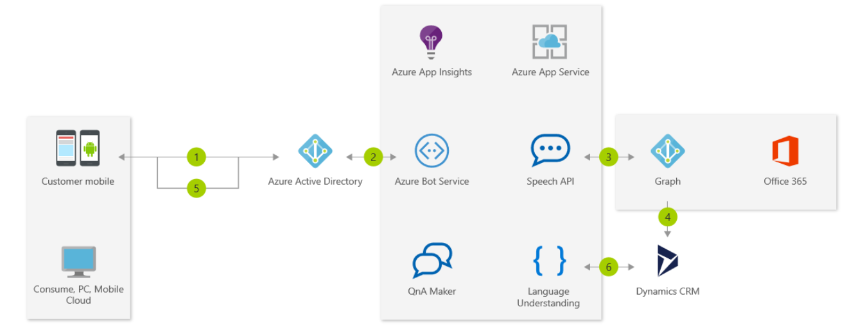
Chat Bots| Enterprise productivity bot
These bots increase productivity of any organization by integrating bots with productivity services like Office 365 and Dynamics CRM and any of their proprietary LoB Applications
.

Slide 30
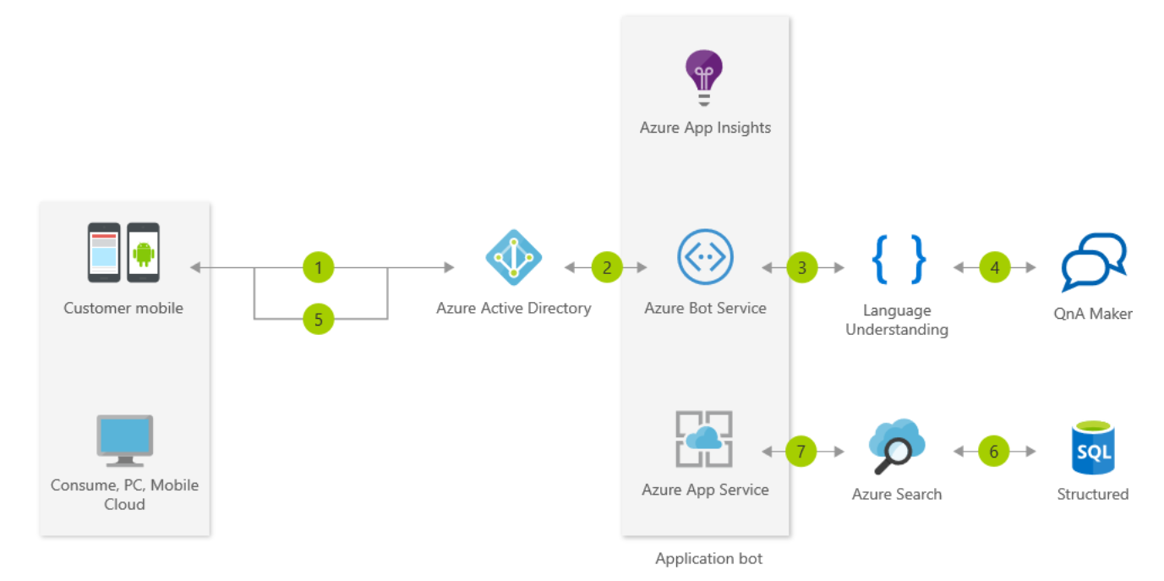
Chat Bots| Information bot
May be the one you've heard the most about. There are lots of use-cases for a bot like this, including: FAQ, IT support, store location and information, open-ended search, retail/inventory...the list goes on. An information bot could be used to answer questions defined in a knowledge set or even more open-ended questions
.

Slide 31
Chat Bots| Common Bot Working Patterns
.
Task automation
Bot enables a user to complete a specific task or set of tasks without any assistance from a human. This type of bot often closely resembles a typical app or website, communicating with the user primarily via rich user controls and text. It may have natural language understanding capabilities to enrich conversations with users.
Examples : How to Reset my Password
Access to knowledge and other content ( Knowledge Mining)
Designed to provide information about virtually any topic. For example, one knowledge bot might answer questions about events such as, "What bot events are there at this conference?", "When is the next show?", or "Who is Tame Impala?" Another might answer IT-related questions such as "How do I update my operating system?" or "Where do I go to reset my password?" Yet another might answer questions about contacts such as "Who is John Doe?" or "What is Jane Doe's email address?
Bot to human handoff
Regardless of how much artificial intelligence a bot possesses, there may still be times when it needs to hand off the conversation to a human being. The bot should recognize when it needs to hand off and provide the user with a clear, smooth transition.

Slide 32
Chat Bots| Common Bot Working Patterns
.
Bot to web browser and back
Transitioning from chat to web browser and back is not ideal, as switching between applications can easily confuse a user. To provide a better experience, many channels offer built-in HTML windows that a bot can use to present applications would otherwise appear in a web browser. This technique allows the user to remain within the conversation while still accessing external resources. This approach is conceptually similar to mobile applications managing authorization flows using OAuth within embedded web views
Two Main Scenarios : Authentication & Authorization, Security & Compliance ( Online Payment)
Communicating with rich text and media
Attachment: You may want to send the user content like an image or video
Hero card: Besides a simple attachment, you can attach a hero card, which allows you to combine images and buttons in one object.
Adaptive card: Adaptive cards make it easier for you to build for one channel and deploy to many, matching the theme of the destination.
Carousel of cards: Use these when you want to include multiple attachments in a carousel layout, which places the attachments side-by-side and allows the user to scroll across (like a carousel...).
Suggested actions: These are great and also known as "quick replies" that can be shown to the user for a single (specific) turn of the conversation, meaning that after the user makes a selection they cannot return and click an "older" suggestion. Suggested actions can be used to decrease the amount of typing for users, as well as to help guide users through a conversation.

Slide 33
Chat Bots| Common Bot Working Patterns
.
Handling Interruptions
You might think that users are good and follow your planned conversation flow with no issues. However, often this is not the case. People change their minds, and you want your bot to be able to manage that. It's important to think about how you want your bot to handle those situations. Since all bots are different, the specifics will depend on your scenario.
Demo

Slide 35
Day 2 closure and Q&A

